Slide 1
Interpreting the retinal neural code for natural scenes: From computations to neurons
Niru Maheswaranathan, Lane T. McIntosh, Hidenori Tanaka, Satchel Grant, David B. Kastner, Joshua B. Melander, Aran Nayebi, Luke E. Brezovec, Julia H. Wang, Surya Ganguli, and Stephen A. Baccus

Slide 2

Notes:
1- Imagine you’re at the Neurobiology retreat at Wrightsville Beach
2- The only reason you can admire this scenery is because light first hits your retina, then this information is decoded by the brain
3- However, the information sent to brain from retina is already preprocessed.
4- In today’s talk we will try to understand how this information is preprocessed

Slide 3
Big picture stuff
I talk:Somehow activity in the photoreceptor leads to perception, the paper today addresses how that happens
How does the retina transmit information?
What do we know about how the retina processes information
RGC activity is very important, that’s the spike code that the brain interprets

Slide 4
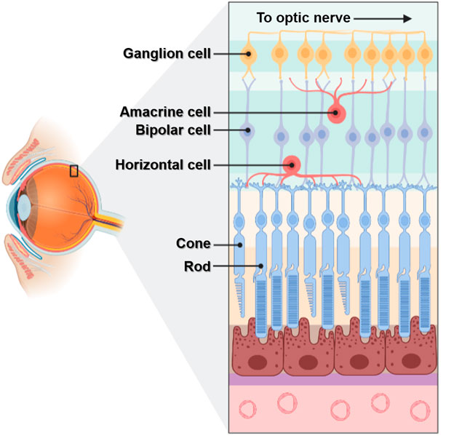
ON pathway: Responds to increments (+) of light
OFF pathway: Encodes decrements (-) of light
Picture taken from Yang, Zhou & Li (2021).

Slide 5
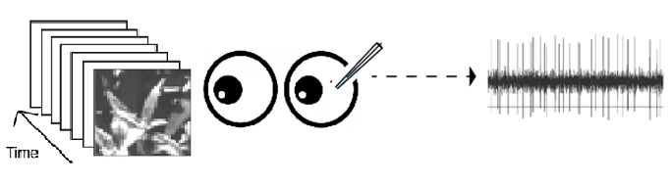
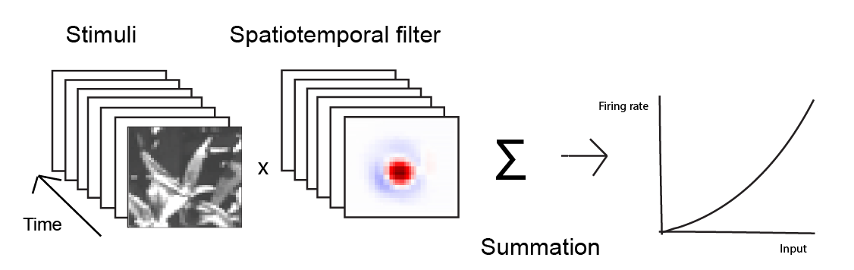
What is the relationship between the images and Retinal Ganglion Cell responses?
Linear model
Experiment
Fitted Model

Slide 6
Limitations of linear model
1. Spiking reliability is very high, but the model predictions are not as reliable
2. We understand input – output relationship, but everything that’s in between isn’t as clear
Maheswaranathan et al. (2021) address this by using a Convolutional Neural Network (CNN) instead of a linear model

Slide 7
Picture taken from Yang, Zhou & Li (2021).

Slide 8

Picture taken from Yang, Zhou & Li (2021).

Slide 9
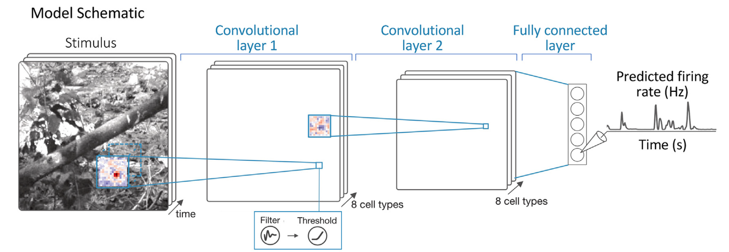
Convolutional Neural Network (CNN) model

Slide 10
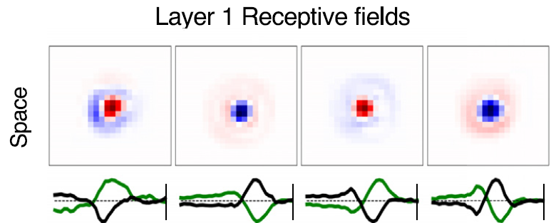
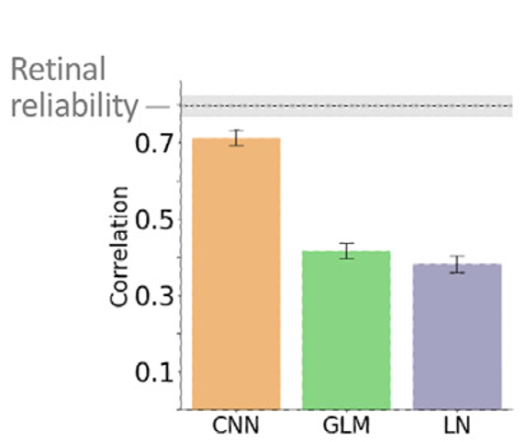
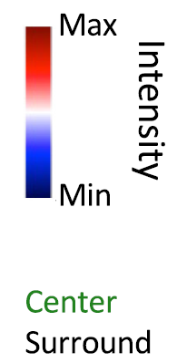

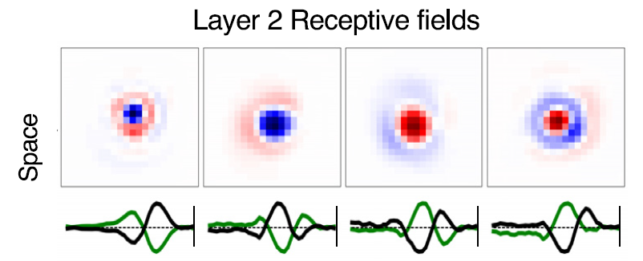
CNN subunits
Explained Variance

Slide 11
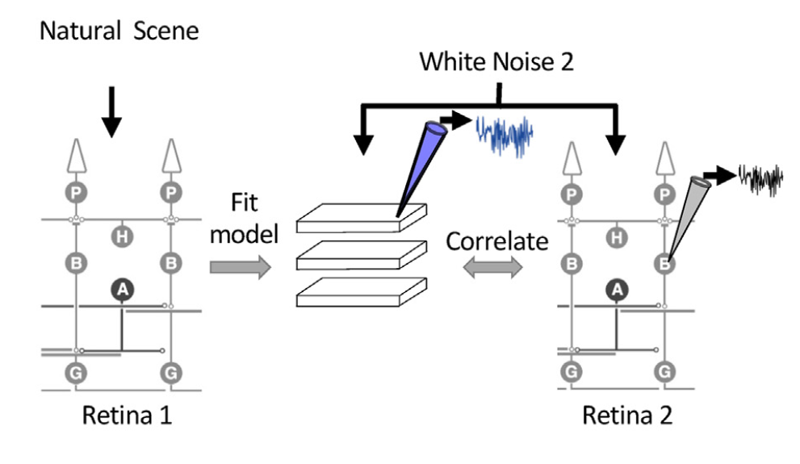
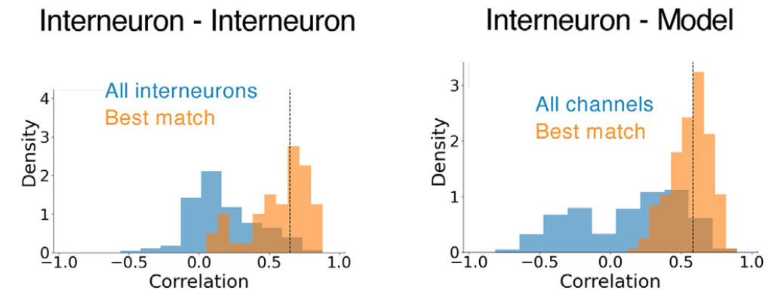

Slide 13
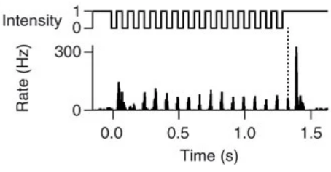
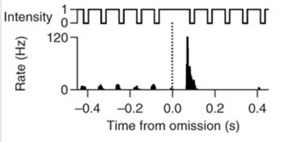
Omitted Stimulus Response (OSR)

